Slide 1
Core Technology:
Cyber Physical Systems
Prepared by: Prof. <name>

Slide 2
Embedded Systems
Information systems, which are embedded into physical devices, are called“embedded systems”.
These embedded systems are found in telecommunication, automation, and transport systems, among many others.
Lately, a new term has surfaced, the cyber-physical systems (CPS).
This distinguishes between microprocessor based embedded systems and more complex information processing systems that actually integrate with their environment.
A precise definition of cyber-physical systems (CPS) is that they are integrations of computation, networking, and physical processes.
Embedded computers and networks monitor and control the physical processes, with feedback loops where physical processes affect computations and vice versa.
Notes:
Before understanding Cyber physical systems, the reader must understand what is an embedded system.
The Industrial Internet has come about due to the rapid advancements in digital computers in all their formats and vast improvements in digital communications. These disciplines are considered separate domains of knowledge and expertise, with there being a tendency for specialization in one or the other. This results in inter-disciplinary knowledge being required to design and build products that require information processing and networking; for example, a device with embedded microprocessor and ZigBee, such as the Raspberry Pi or a smartphone. However, when we start to interact with the physical world, we have a physical domain to contend with and that requires special knowledge of that physical and mechanical domain such as that of a mechanical engineer. Therefore, it is necessary to identify early in the design process whether the product is to be an IT, network, or a physical system–or a system that has all three, physical, network, and digital processing features. If it has, then it is said to be a cyber-physical system. In some definitions, the networking and communications feature is deemed optional, although that raises the question as to how a CPS differs from an embedded system.

Slide 3
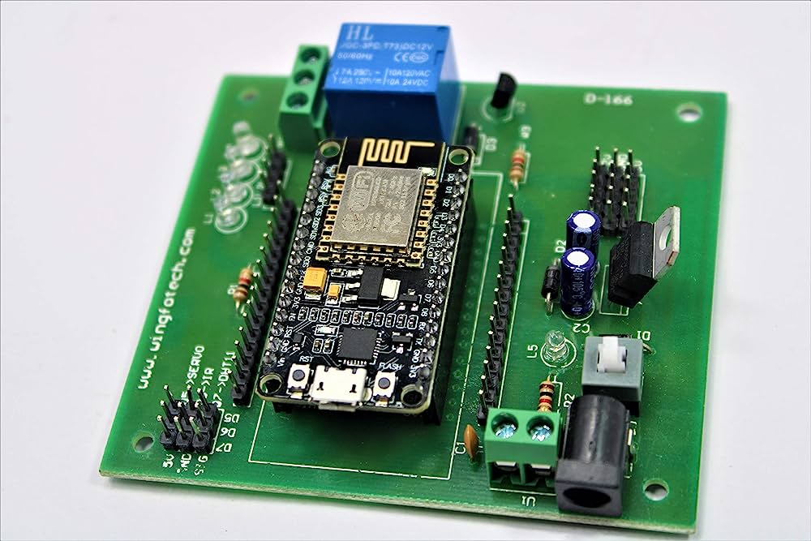
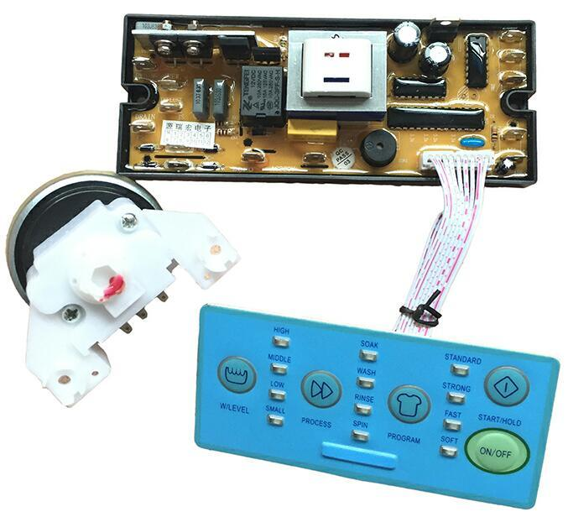
Some embedded systems
Notes:
First picture shows and embedded system for a washing machine, it connects with physical devices such as button switches for taking user input, and motors for driving the wash tub.
Similarly, second figure shows a simple embedded system for switching a device on/off wirelessly.

Slide 4
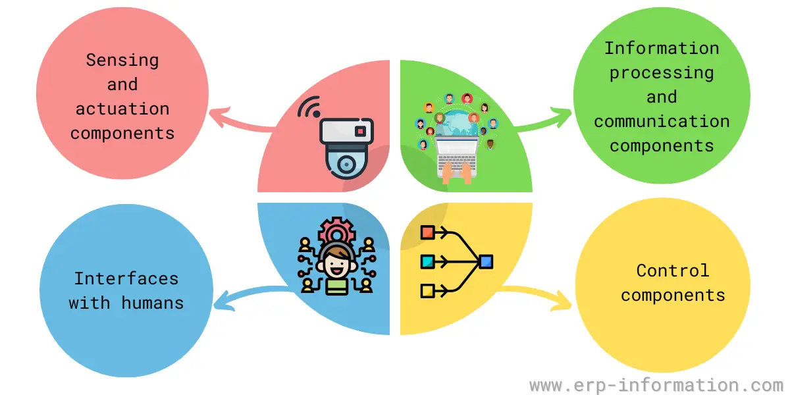
Cyber Physical Systems
Notes:
Sensing and actuation components
Sensing and actuation components allow a CPS to interact with the physical world. That could involve embedded sensors that measure parameters like temperature or pressure. The data collected by these sensor networks must be processed and communicated to other parts of the system, so that appropriate decisions can be made, for example, turning a heater on or off in response to changes in temperature.
Information processing and communication components
These are necessary to decide how to actuate on the physical system. For example, that could involve an embedded processor that runs algorithms to make decisions based on sensor data. The processed data must then be communicated to other parts of the system to take appropriate actions.
Control components
Control components ensure that the system behaves as intended. That could involve a controller that regulates the flow of information and controls the system’s actuation. The control component must be designed to ensure that the system meets its objectives while considering uncertainties in the physical world.
Interfaces with humans
Allow people to interact with the information system. That could involve a graphical user interface that enables users to monitor the system and input commands. Again, it is essential to consider how users will interact with the system to ensure that it is easy to use and understand.

Slide 5
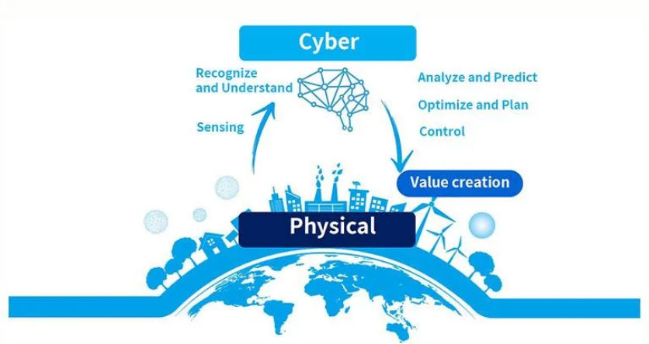
Cyber Physical Systems (CPS)
A cyber-physical system can be just about anything that has integrated computation, networking, and physical processes. A human operator is a cyber-physical system and so is a smart factory.
Source: Toshiba
Notes:
For example, a human operator has physical and cyber components. In this example, the operator has a computational facility—their brain—and they communicate with other humans and the system through HMI (human machine interface) and interact through mechanical interfaces—their hands—to influence their environment.

Slide 7
Cyber-physical systems enable the virtual digital world of computers and software to merge through interaction—process management and feedback control—with the physical analogue world, thus leading to an Internet of Things, data, and services.
One example of CPS is an intelligent manufacturing line, where the machine can perform many work processes by communicating with the components and sometimes even the products they are in the process of making.
An embedded system is a computational system embedded within a physical system; the emphasis is on the computational component. Therefore, we can think of all CPS as containing embedded systems, but the CPS’s emphasis is on the communications and physical as well as the computational domains.

